Slide 1
The A-Z of Geo Skills
Part 2: N to Z

Slide 2
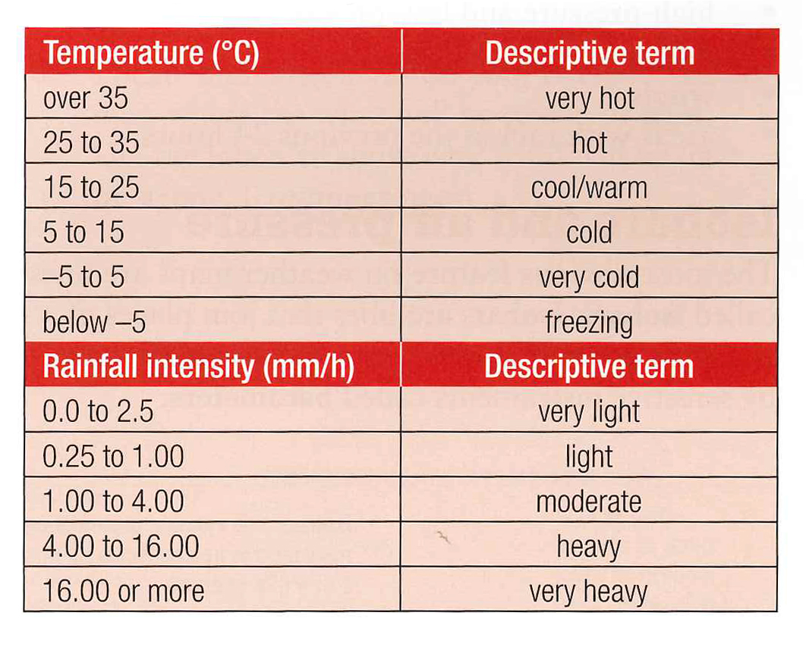
W
Weather (1)
• Weather can be defined as the state of the atmosphere at a particular place & time
• Weather is different from climate which is the state of the atmosphere over a prolonged period of time
• Weather only happens in the troposphere which is the layer of the atmosphere closest to earth (16km high)
• Because the Earth’s surface varies from hot to cold and sea to land the atmosphere above also varies – the weather we feel is caused by the movement of air masses
The A-Z of Geo Skills
Descriptive terms for the weather

Slide 3
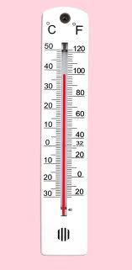
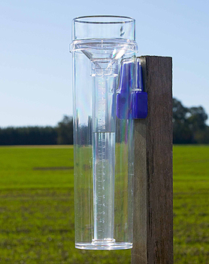
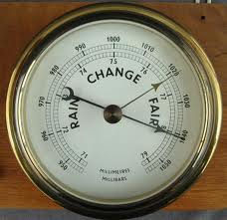
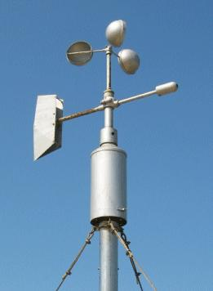
W
Weather (2)
Element | Description | Measured by
Temperature | The warmth of the surrounding air caused by the Sun | Thermometer
Precipitation | All forms of moisture – rain, hail, sleet, snow, dew and frost | Rain gauge
Humidity | The amount of moisture the air can hold at a particular temperature | Hygrometer
Air pressure | The ‘weight’ of air pressing on the Earth’s surface | Barometer
Sunshine | Hours of sunlight in a day | Sunshine recorder
Wind | The movement of air of varying warmth and moisture named by the direction from which it blows | Anemometer (km/hr) also Beaufort Scale
Cloud Cover | Concentrations of water vapour, named by their shape, size, height and thickness – measured in eighths with zero being clear | Human observation
The A-Z of Geo Skills
The elements of weather

Slide 4
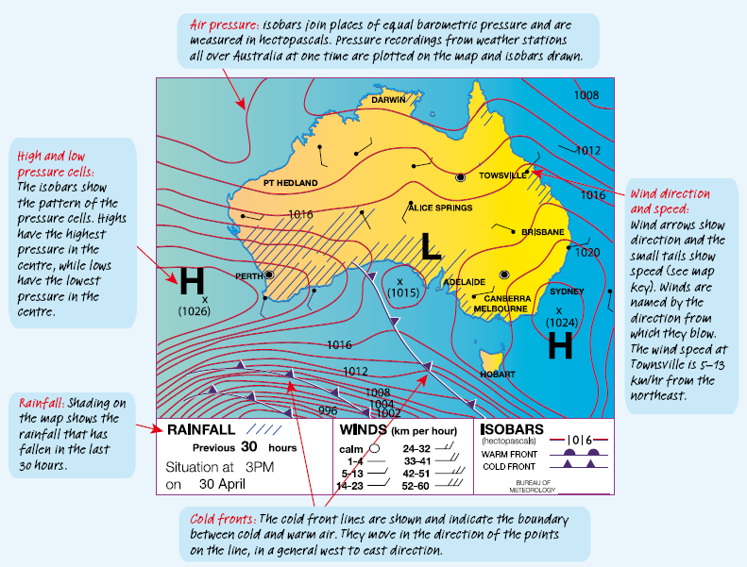
W
Weather (3)
• A weather map is also called a synoptic chart
• This shows us a synopsis of the weather conditions at a particular time
• The main features are: isobars, cells, fronts, winds
and rainfall
(shown adjacent)
The A-Z of Geo Skills
Reading a weather map (aka a synoptic chart)

Slide 5
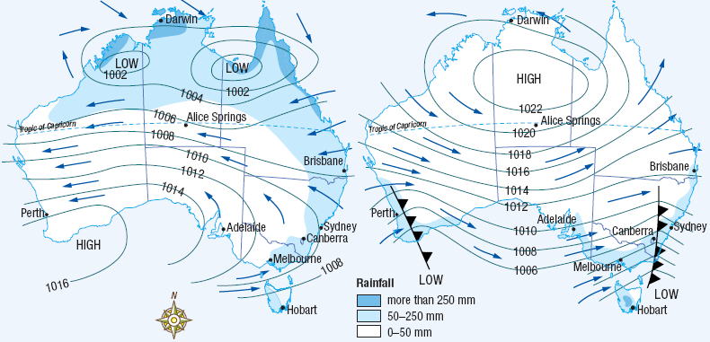
W
Weather (4)
• Exam style questions
Exam style questions:
Q1) In Fig. 1, what is the air pressure in Adelaide?
Q2) In Fig. 2, what is the weather feature approaching Sydney?
Q3) In Fig. 1 how much rainfall is in Brisbane ?
Q4) In Fig. 1 which season do you think is represented and why?
Q5) In Fig. 2 what is the wind direction at Perth?
The A-Z of Geo Skills
Figure 1
Figure 2
Q6) In Fig. 2, describe the weather conditions in Alice Springs.

Slide 6
W
Weather (4)
• Exam style questions
ANSWERS:
Q1) In Fig. 1, what is the air pressure in Adelaide?
1012 hPa – 1014 hPa
Q2) In Fig. 2, what is the weather feature approaching Sydney?
Cold front
Q3) In Fig. 1 how much rainfall is in Brisbane ?
50-250 mm
Q4) In Fig. 1 which season do you think is represented and why?
Summer, wet season and low cells in the Nth
Q5) In Fig. 2 what is the wind direction at Perth?
SW
The A-Z of Geo Skills
Figure 1
Figure 2
Q6) In Fig. 2, describe the weather conditions in Alice Springs.
Fine, sunny, settled, clear skies, light westerly breeze

Slide 7
The End
Phew…
Good luck in mastering your Geo Skills

